Slide 1
Group Overview
November 2017

Slide 2
In a rapidly changing business climate
IT Services companies are often only seen…
… as
technology companies
Group Presentation | November 2017
© Capgemini 2017. All rights reserved |
2

Slide 3

At Capgemini we see things differently
We believe that technology is made
by people, for people
People
are at the center of everything we do
Group Presentation | November 2017
© Capgemini 2017. All rights reserved |
3

Slide 4

From purpose ...to creating impact
Our Vision
The business value of technology comes
from and through people
Our Mission
With you, we create and deliver business and technology solutions that fit your needs and drive the results you want
Group Presentation | November 2017

Slide 5

Our motto
It’s the quality of our people, and their capacity to deliver solutions that fit, with you and for you, that drive real business results.
© Capgemini 2017. All rights reserved |
5

Slide 6
Our seven foundation values
Honesty
Boldness
Trust
Freedom
Team Spirit
Modesty
Fun
Our Values
guide our business decisions and shape our culture
Group Presentation | November 2017
© Capgemini 2017. All rights reserved |
6

Slide 7
The way we work
From People
Through Innovation
To Results

Slide 8

We are a multicultural people company (as of September 2017)
North America
~17,490
Latin America
~8,160
Europe
~ 200,000 people worldwide
working together as one team
~65,980
Middle-East & Africa
~1,540
Asia-Pacific
~5,240
India
~100,190

Slide 9

We have a competitive global delivery model
The right balance to global delivery and sourcing
Cost Reductions
Streamlined Processes
Innovation
Leveraging the right Talent and the latest Technology to deliver you the future.
As One Team, we help you become more competitive. Anywhere. Anytime.
to do more with less while staying competitive
to improve productivity and compliance
to transform your business
Competitive Advantage
Growth
Automation
to improve quality and predictability with the latest technology
with solutions that expand your business
to drive agility and cut time-to-market with new ways of working

Slide 10

We commit to an inclusive workplace where people can engage to drive a positive social and environmental impact
Over 53,000 hires of which 40% are young professionals from the best schools and universities. We foster professional development and well-being of our employees.
Diversity and inclusion
Community Engagement
Environmental Sustainability
Nurturing an open, diverse and inclusive environment where each individual can bring his or her authentic self and thrive.
Diversity at Capgemini encompasses gender, sexual orientation, disability, ethnicity, culture, race, age and religion, social background, personal style… For true diversity of thought.
Diversity fuels excellence and innovation for our clients.
Support social development and empowerment of communities in the countries we operate in.
Our objective: to touch 1 million lives by 2020.
Foster education at all levels and for all ages, from elementary school to higher and professional education.
Use technology to accelerate social innovation.
A commitment made following the Paris Agreement on climate change (COP21) to reduce carbon emissions (GHG). Set targets to reduce total carbon emissions per employee by 20% by 2020 and 40% by 2030.
Embed sustainability in our offers.
Values and ethics: The foundation to who we are and how we behave
Seven core values: Honesty, Boldness, Trust, Freedom, Team Spirit, Modesty, and Fun
2017 World’s most ethical companies® recognition for the 4th year in a row

Slide 11
The way we work
From People
Through Innovation
To Results

Slide 12

From the introduction of disruptive innovation …
The sheer velocity of technological change is driving an ever-growing appetite for new solutions and capabilities.
There are endless arrays of business challenges and opportunities - a new paradigm of perpetual change is here to stay.
Yet most companies lack the competencies necessary to apply, adopt, consume, deploy, or sustain innovation.
How do enterprises position themselves to realize the value of business innovation—with speed, scale, safety, and certainty that are implied by innovation—and make it a core competency?
© Capgemini 2017. All rights reserved |
12

Slide 13
…to Applied Innovation
For the successful digital enterprise, innovation is not a random act. Innovation is a discipline based on a business outcome. It’s a strategic exercise that can be planned, managed, and measured.
A framework for discovery, contextualization, deployment, and sustainability
The curation, orchestration, and governance of a global ecosystem of experts and third parties, including start-ups
Addressing issues of culture, vision, risk tolerance, legacy integration, talent, and more

Slide 14
Our manifesto of applied innovation
Ideas are currency.
Knowledge is capital.
Innovation, brilliantly applied, is gold.
But innovation without ironclad application is a bankrupt proposition.
This is a profoundly uncertain, perpetually disruptive marketplace. The risks are real, yet the opportunities are immense. Amateurs need not apply. Choose your guide wisely.
In choosing innovations to apply, your only bias should be toward creating business success.
Finding and applying the most relevant innovations for your industry and business is a team sport. Stack your bench with deep vertical expertise. Scout the wide universe of innovations to fill an ever-evolving playbook.
Become technologically omniscient.
Never stop discovering. Be endlessly creative in applying your discoveries.
Check your preconceptions at the door.
Applied Innovation changes everything
© Capgemini 2017. All rights reserved |
14

Slide 15
Our global platform to applied innovation
End-to-end high performance engagement experience
An immersive and transformative environment providing the infrastructure to innovate at speed and scale
Multi-disciplinary and open global ecosystem of leading businesses, technology partners, startups, academia, venture capitalists and much more
Toronto
London
Utrecht
Lille
Munich
Paris
San Francisco
Toulouse
New York
Mumbai
Innovative design teams that are part of the Group
Fahrenheit 212
Backelite
Idean
Product and Engineering Services
Singapore
Melbourne

Slide 16
The way we work
From People
Through Innovation
To Results

Slide 17

From a complete range of businesses …
Consulting
Services
Application Services
Technology
and engineering services
Other Managed Services
We use our extensive industry expertise to advise on strategy and help you to transform your business and technology landscape
We provide a next-generation approach to application development, system integration, and maintenance
We deliver technology services to suit local requirements for infrastructure, applications, engineering, testing and operations
We integrate, manage, (co-)develop your IT infrastructure systems, transaction and on demand services and/or business activities

Slide 18
…to innovative services and products
Moving to the digital age
Digital Customer Experience
Cloud Choice
Apply innovation
to transform your business
Manage your journey to the cloud
Cybersecurity
Insights & Data
Optimize your
operations
Business Services
Disrupt your
market with digital
Major challenges
Digital Manufacturing
Automation Drive
Quality Assurance & Testing
Gain advantage with IT applications
Product & Engineering Services
Control and secure your assets
Application Development and Maintenance

Slide 19


From novelty or opportunity to disruption …
Connect
The legacy and the new
Digital age imagination, speed and agility
The fundamentals: performance, reliability, scalability, sustainability, and security
The emerging with the established
Making today’s business relevant for tomorrow
From enterprise grade and industrial strength to the endless opportunities of the radically new
IoT, AI, VR, AR, Robotics new business models
Vision and reality
Moving with confidence and speed from business intent to value creation
The magic and the money
People and technology
Strong technology foundations, connecting the virtual and physical worlds (IT, OT, and IoT)
Deep change management and transformational expertise
© Capgemini 2017. All rights reserved |
19

Slide 20
…to a mainstream topic impacting all of your digital business
Cloud Choice
Digital needs to be pervasive—tinkering at the edges is not enough.
Cybersecurity
Insight & Data
Digital needs to be in every part of the organization to make its effect truly felt.
Digital Employee Experience
Digital Customer Experience
So all of your people, customers, suppliers, physical and digital assets—all need to feel the effect and deliver better outcomes.
Digital Manufacturing
Innovation Consulting
© Capgemini 2017. All rights reserved |
20

Slide 21
From cloud-first intent …
Overcome the barriers to cloud adoption:
Unlock the real benefits of being cloud first:
Legacy IT
Security, privacy, and availability
Compliance and regulation
Ownership and governance
Skills gaps
Process limitations
Efficiency
Agility
Scalability
Innovation
Transformation
Cloud is becoming a ubiquitous delivery option for all kinds of IT—but few enterprises today are truly cloud first
© Capgemini 2017. All rights reserved |
21

Slide 22

…to cloud-first reality
Advise
Align
Animate
Build the roadmap and business case for cloud
Transforme the applications portfolio by migrating to the cloud, or building new cloud-native applications
Allocate workloads to public, private or hybrid cloud infrastructure, safely and controlled
Cloud Choice
A complete portfolio of services that deliver a cloud-first way of working for the enterprise.
Over 5,000 cloud projects delivered for large enterprise customers worldwide since 2013.
Group Presentation | November 2017

Slide 23


From automation …
Automation—helping you achieve more with less to deliver better business outcomes.
When we combine machine power with business vision, we find new ways to innovate and turn automation into an engine for business growth.
When you have to:
Navigate change and orchestrate new, innovative ways of working
Embrace business challenges and use them as opportunities to embark on new journeys—rethinking and reimagining the way you do business
© Capgemini 2017. All rights reserved |
23

Slide 24


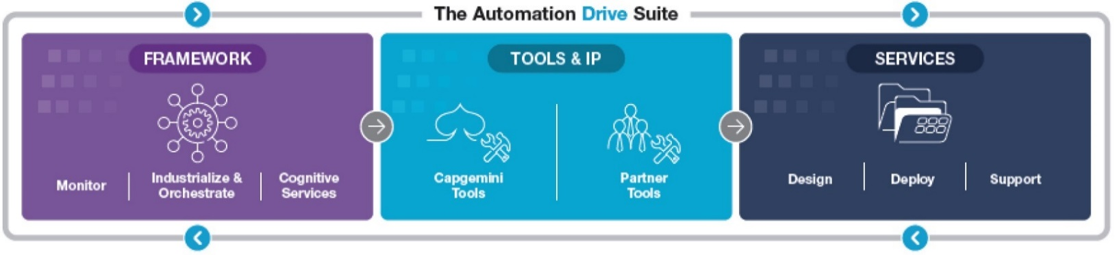
…to business reimagined
HOW?
Automate your processes to drive new paths to growth
Automate your technology to drive greater efficiency and resilience
Automate your decision making to drive greater agility and responsiveness
A unified, open and dynamic Suite integrating automation tools and services including: Monitoring, User Interaction, Analytics, Service Automation & Orchestration, AI, and Cognitive Services.
Group Presentation | November 2017

Slide 25


From cyber threat awareness …
IT systems
Stay ahead of increasingly sophisticated threats
Your enterprise needs to:
Secure its digital transformation and move to cloud
Be well governed, compliant, and secure
Control security related costs
IoT (Internet of things)
Across
Operational Technology Systems
Group Presentation | November 2017

Slide 26


…to controlling and securing assets
YOUR BUSINESS WILL…
YOUR CUSTOMERS WILL…
A 360°
Access the best domain experts worldwide
Benefit from packaged offers powered by the best technology products
Be secure and compliant with regulations
Optimize costs with as-a-service offers
Trust you
Access digital services securely
Live an enhanced customer experience
end-to-end future-focused approach to control and secure your assets
© Capgemini 2017. All rights reserved |
26

Slide 27


From Business Services ...
End-to-end processes for FAO, Procurement, Supply Chain, HRO, Customer Service & Support and Analytics
One
integrated solution that delivers business
outcomes
Industry know-how and world-class solutions across all major sectors
25,000 experts, 24/7/365 Global Operations in 38 languages, across 21 centers
Proven methodologies (Global Enterprise Model©) and fully integrated technology and operations (ITOPS)
Technology Platforms and IPR
© Capgemini 2017. All rights reserved |
27

Slide 28
…to business and IT operations excellence
Your clients, buyers, employees will:
Your business will:
Pay quicker
Re-imagine your
Have more opportunities
Buy more
business value chain
Strengthen reputation
Perform better
Boost revenue and margin
Be happier!
Achieve higher customer, buyer, employee, investor satisfaction

Slide 29














From strong expertise in industry sectors …
Recurring
Thought Leadership program
Investment in sectorial Centers of Excellence
Affiliation to industry bodies
Financial Services
Retail and CPG
Insurance and financial services
Consumer Goods Forum
GS1
LOMA
SWIFT
Consumer Products
and Retail
Cells Life Sciences
Automotive
We understand the complexities of your sector, make proactive investments in research and innovation, and network with industry bodies to establish thought leadership and help you stay ahead of the game.
Utilities

Slide 30
…to scripting success worldwide
27 of the world’s 30 largest consumer products companies
14 of the world’s 15 largest automotive OEMs
12 of the top 15 largest automotive suppliers
12 out of the top 20 Utilities companies
9 of the top 15 banks
6 of the top 10 consumer finance companies
13 of the top 15 asset finance companies
10 of the 15 largest investment banks

Slide 31
2016 Performance
Energy, Utilities & Chemicals
Financial Services
Public Sector
Application Services
Others
Other Managed Services
Revenue by Business
Revenue by Industry
Manufacturing, Automotive
& Life Sciences
Technology and
Engineering Services
Telecom, Media & Entertainment
Consulting Services
Consumer Product, Retail, Distribution & Transportation
Revenue
€12,539
million
Operating Margin
€1,440
million
Operating Profit
€1,148
million

Slide 32

Market recognitions
In the Leaders category in The Forrester Wave™: Salesforce.com Implementation Partners in 2015 (June 2015)
As a Leader in IDC MarketScape: Worldwide Application Modernization Services for Digital Transformation Vendor Assessment (Dec. 2015)
In the Leaders category in The Forrester Wave™: Services Providers for Next-Generation Oracle application projects, Q3 2016
As a Major Player in the IDC MarketScape: Worldwide Big Data Consulting and Systems Integration Services 2016 Vendor Assessment (May 2016)
2015
2016
As a Major Player in the IDC MarketScape: Worldwide Business Analytics Consulting and Systems Integration Services 2016 Vendor Assessment (Apr 2016)
As a Major Player in the IDC MarketScape on Digital Strategy Consulting in 2016 for Worldwide, North America, EMEA and Asia Pacific (May 2016)
In the Leaders category in The Forrester Wave™: Global Infrastructure Outsourcing Wave™, Q1 2015. (Jan 2015)
As a Leader in the Gartner Magic Quadrant for SAP Implementation Services, Worldwide. (July 2015) *See disclaimer
As a Leader in The Forrester Wave ™: Services Providers For Next-Generation SAP Products, Q1 2016

Slide 33




From a start-up …to a global leader
1967
2017
7 people in Grenoble, France
+190,000 employees in over 40 countries
Group Presentation | November 2017
© Capgemini 2017. All rights reserved |
33

Slide 34









From a 50 years track record as an independent company …
1967
1991
2002
2011
SoGETI founded by Serge Kampf in Grenoble, France on October 1
Creation of Consulting resulting from the merger of five management consulting firms
Name revived to offer Local Professional Services
The Board of Directors name Paul Hermelin, CEO
Opening of an international training and conference center in France at Les Fontaines
Eight acquisitions, including Prosodie, leader in front office transaction solutions
2012
1968
1993
Paul Hermelin is appointed Chairman & CEO
Gemini Computer Systems Inc. based in New York
First transformation program of the Group’s organization, sales approach, methods and culture, called “Genesis”
2004
2013
Name and logo changed to
coinciding with global ad campaign to position “The Collaborative Business ExperienceTM”
At 24th Rencontres in San Francisco, prominent industry leaders and partners acknowledged Capgemini as a Global Leader in its market.
Capgemini has been named by the Ethisphere Institute’s as one of the World’s Most Ethical Companies for 2013 (for the first time)
1973
1996
Sogeti, Gemini Computer Systems and CAP merged as
The Group reorganized its shareholding and management structure and adopts a new name and a new logo:
1975
2007
1998
Capgemini acquires Kanbay and Indigo, expanding its offshore capabilities in India
First Annual Report published
Cap Gemini is included on the CAC 40 listing on the Bourse
2014
1978
1999
2009
Acquisition of Euriware
Cap Gemini Inc. established in Washington DC
Cap Gemini is voted "European Company of the Year" by the European Press Federation
Consulting Services becomes a global entity:
2015
Acquisition of IGATE
1985
2000
2010
2016
Cap Gemini Sogeti listed on the "Second Market" of the Paris Stock Exchange
Acquisition and merger with Ernst & Young Consulting to form
Acquisition of CPM Braxis in Brazil
March 15: Founder Serge Kampf passes away at the age of 81

Slide 35


…to an ever changing world
Enabled by OUR PEOPLE
And Capgemini changes with it.
Leading the transition to the
ERA OF DIGITAL

Slide 36


Connect with us
Visit our website
Keep up to date on social media
capgemini.com
Discuss innovations with our specialists
Follow the best of business and technology news
capgemini.com/expert-connect
content-loop.com
Learn about tomorrow’s tech trends and innovation
capgemini.com/beyond-the-buzz

Slide 38



Appendix

Slide 39
Full year revenues by business
FY 2016
FY 2016
Other Managed Services
Consulting Services
Application Services
Technology and Engineering Services

Slide 40
Full year revenues by main geography
FY 2015
FY 2016
North America
France
Rest of Europe
UK & Ireland
Benelux
Asia-Pacific & Latin America

Slide 41
Full year revenues by sector
FY 2015
FY 2016
Energy, Utilities & Chemicals
Public Sector
Consumer Product, Retail, Distribution & Transportation
Others
Financial
Services
Telecom, Media & Entertainment
Manufacturing, Automotive &
Life Sciences

Slide 42


Headcount evolution
December 2015 to December 2016
+11,274
+1,165
+6.9%
180,639
193,077
Dec.2015
Net Variation Offshore
Net Variation Onshore
Dec.2016
© Capgemini 2017. All rights reserved |
42

Slide 43
Revenue Evolution 2006 - 2016
in M€

Slide 44

Quarterly Revenue Evolution 2012 - 2016
FY 2012
€ 10,264m
FY 2013
€ 10,092m
FY 2014
€ 10,573m
FY 2015
€ 11,915m
FY 2016
€12,539m
in M€

Slide 45
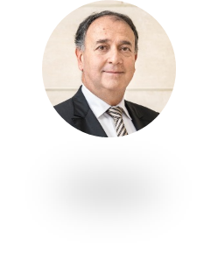
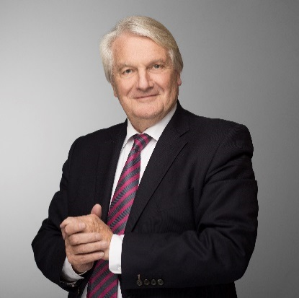
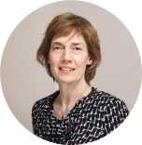
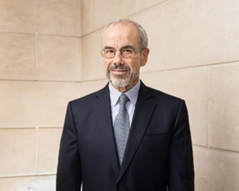
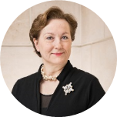
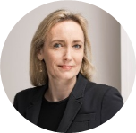
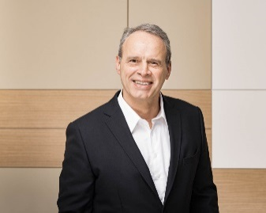
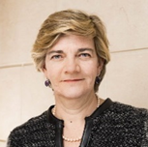
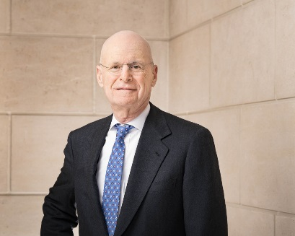

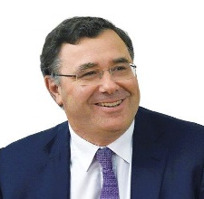

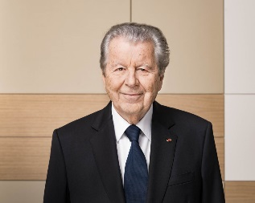
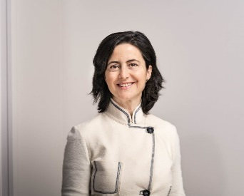
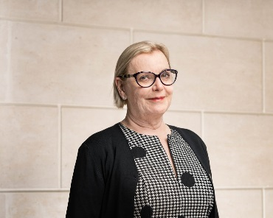
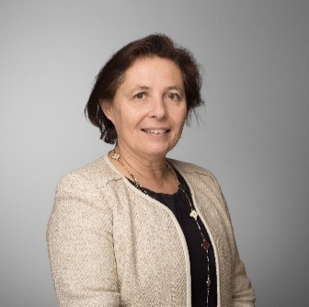
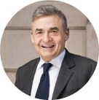
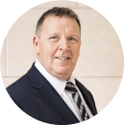
Board of Directors (As of May 10, 2017)
Paul Hermelin
Chairman and CEO
Daniel Bernard
Anne Bouverot
Yann Delabrière
Laurence Dors
Carole Ferrand
Robert Fretel
Siân Herbert-Jones
Phil Laskawy
Xavier Musca
Patrick Pouyanné
Pierre Pringuet
Bruno Roger
Lucia Sinapi-Thomas
Caroline Watteeuw-Carlisle
Secretary of the International Works Council
Statutory Auditors
Françoise Garnier pwc
Frédéric Quelin KPMG
Kevin Masters
Group Presentation | November 2017
© Capgemini 2017. All rights reserved |
45

Slide 46

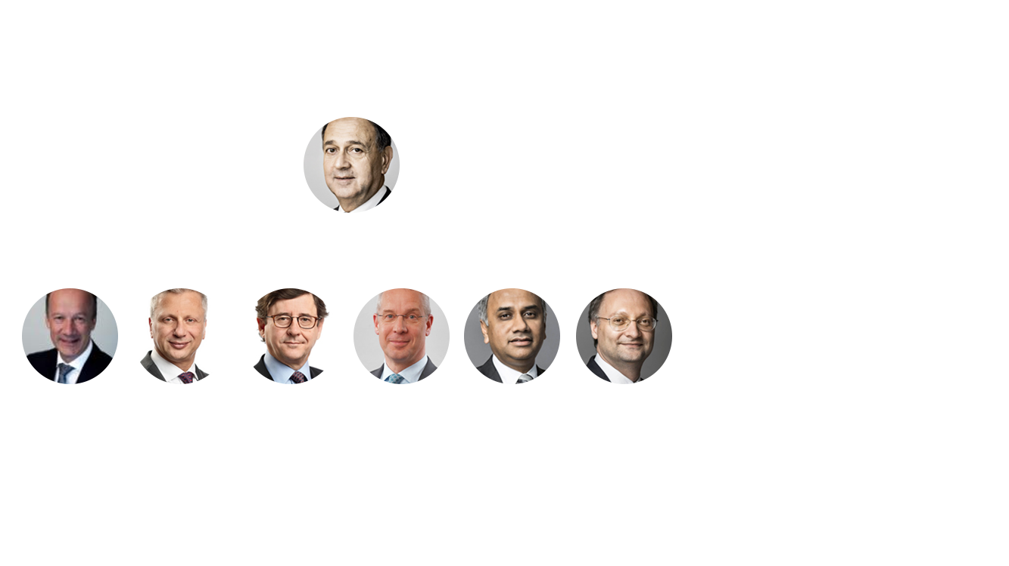

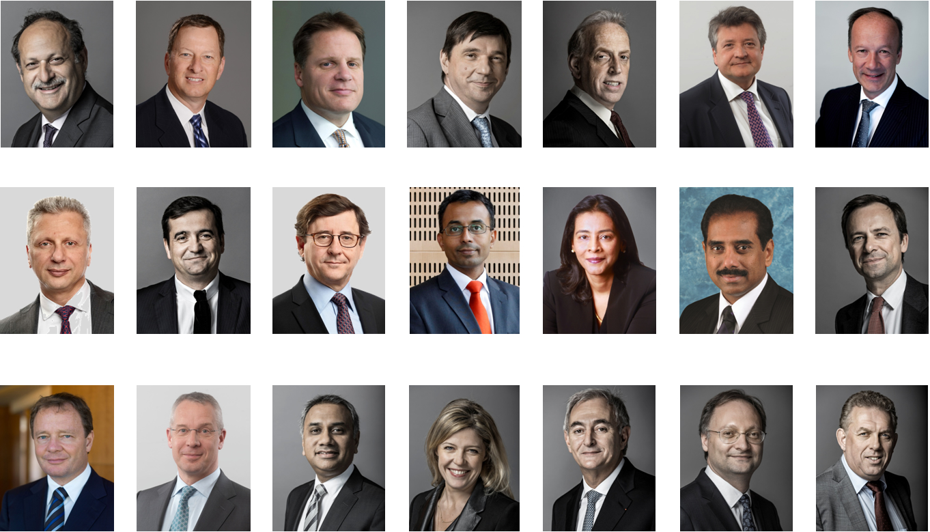
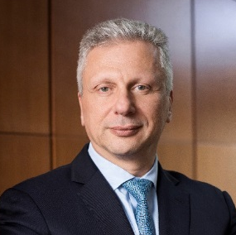
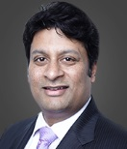
Group Executive Board (GEB) (As of January 2018)
Paul Hermelin
Group Chairman and CEO
Thierry Delaporte
Chief Operating Officer
Aiman Ezzat
Chief Operating Officer
Chief Financial Officer
Hubert Giraud
People Management and Transformation
Patrick Nicolet
Chief Technology Officer
Anirban
Bose
Financial
Services
Olivier Sevillia
Application Services Two, Business Services, Capgemini Consulting and Digital Services
Group Presentation | November 2017
© Capgemini 2017. All rights reserved |
46

Slide 47
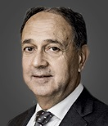
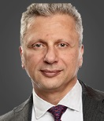
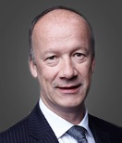
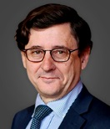
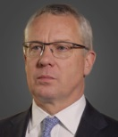
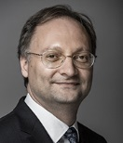
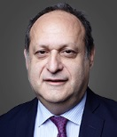
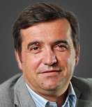
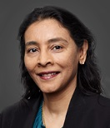
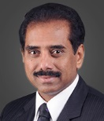

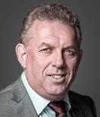
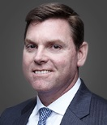
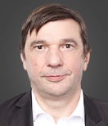
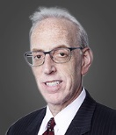
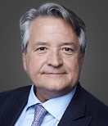
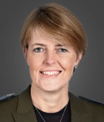
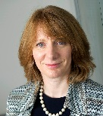
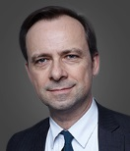

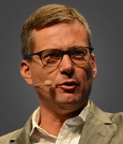
Group Executive Committee (GEC) (As of January 2018)
Paul Hermelin
Aiman Ezzat
Thierry Delaporte
Hubert Giraud
Patrick Nicolet
Anirban Bose
Olivier Sevillia
GEB members
Group Chairman & CEO
CFO & COO
COO
People Management & Transformation
CTO
FS
AppsTwo, Apps UK-HMRC, BSv, AMSI program
Jean-Philippe Bol
Cyril Garcia
Aruna Jayanthi
Srinivas Kandula
Luc-François Salvador
Hans van Waayenburg
John Mullen
Operations
Cloud Infrastructure Services + Coud
Capgemini Consulting, Digital
Business Services
India
Asia-Pacific
Sogeti
Apps North America
André Cichowlas
Lanny Cohen
Pierre-Yves Cros
Christine Hodgson
Rosemary Stark
Jean-Baptiste Massignon
Virginie Régis
Jean Coumaros
Central functions
Quality & Delivery
Innovation & AIE
Strategy & Development
Corporate Social Responsibility
Sales
General Secretary
Marketing & Communications
LEAD program

